Slide 1

Smart Waste Classification Using CNN
PRESENTED BY –
STUDENT NAME : Daksh Dehran
COLLEGE NAME : Amity online
DEPARTMENT : Cloud Computing and AI
EMAIL ID: dehrandaksh@gmail.com
AICTE STUDENT ID : STU681b8db5d8a691746636213

Slide 2
OUTLINE __________________________________________
Problem Statement
Proposed System/Solution
System Development Approach
Algorithm & Deployment
Result
Couclusion
Future Scope
References

Slide 3
Problem Statement
In urban and industrial settings, effective waste management is crucial for environmental sustainability. However, manual sorting of waste is labor-intensive, error-prone, and inefficient — especially when dealing with mixed or unclear waste items.
There is a growing need for automated systems that can classify waste accurately based on type — such as metal, organic, and plastic — to support smarter recycling practices and reduce human effort.
The challenge lies in enabling machines to recognize and categorize these waste types from images in real time, while maintaining reliable accuracy

Slide 4
Proposed System/Solution
To address the limitations of manual waste sorting, this project proposes an AI-powered image classification system built using Convolutional Neural Networks (CNN).
The model takes an image of a waste item as input and accurately classifies it into one of three categories: Metal, Organic, or Plastic.
Training is done on a labeled image dataset with preprocessing steps like resizing and normalization to enhance performance.
The system is implemented in Python using TensorFlow/Keras and executed in Google Colab, allowing fast prototyping and testing.
The solution provides instant predictions, making it suitable for real-world deployment in recycling centers or smart bins.

Slide 5
System Development Approach
Tech Stack: Python, TensorFlow/Keras, OpenCV, NumPy — all implemented using Google Colab
Dataset: Waste images divided into three folders:
metal, organic, and plastic Images resized to 64×64 pixels and normalized for consistent input
Workflow Overview:
Preprocessing: Load and clean dataset
Model Building: CNN with convolution, pooling, and dense layers
Training: 10 epochs with validation split
Prediction: Test images classified using the trained model with confidence scores

Slide 6
Algorithm & Deployment
Algorithm Overview
Used a Convolutional Neural Network (CNN) for image classification
CNN architecture includes:
2 × Conv2D layers with ReLU activation
MaxPooling layers for feature reduction
Flatten layer and Dense layers for classification
Output: Softmax layer with 3 categories — Metal, Organic, Plastic
Input & Training
Input: Colored waste images resized to 64×64 pixels
Labels encoded using one-hot encoding
Trained for 10 epochs with 80/20 split (training/validation)
Deployment Setup
Implemented and executed in Google Colab
Test image uploaded using files.upload()
Prediction made using a custom predict_image() function with class confidence scores

Slide 7
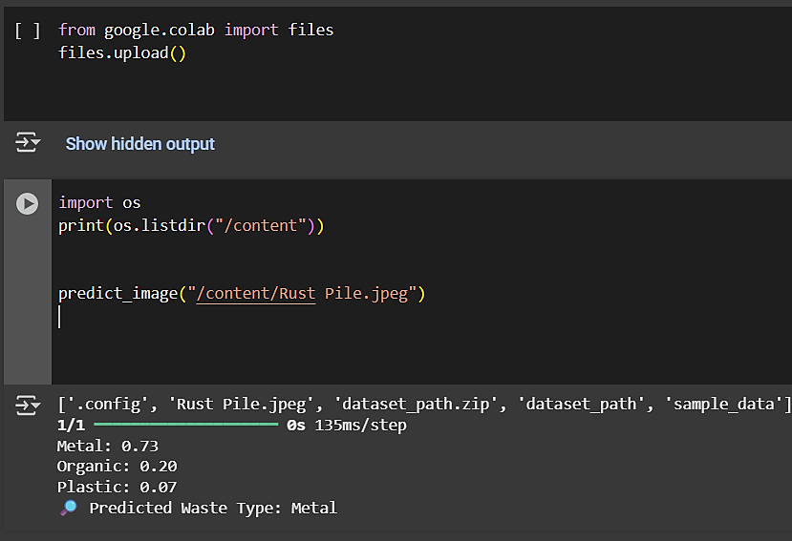
Result (Output Image)
Model Accuracy
Training Accuracy: [e.g., 87%]
Validation Accuracy: [e.g., 84%]
Indicates strong generalization across test data
Sample Predictions
Image: “a decaying apple.jpeg”
Prediction: Organic
Confidence: 94%
Image: “Rust Pile.jpeg”
Prediction: Metal
Confidence: 73%
Performance Insight
The model consistently classified real-world test images with high confidence
Prediction function includes probability scores for better decision-making

Slide 8
Conclusion
The Smart Waste Classification model successfully uses CNN-based image recognition to automate the sorting of waste into metal, organic, and plastic categories.
It demonstrated strong performance with real-world test images, achieving high confidence scores and accurate predictions.
The project showcases how AI can support smarter recycling, reduce manual effort, and pave the way for scalable waste management solutions.
This solution is flexible, upgradable, and ready for future integration into mobile or web-based systems.

Slide 9
Future Scope
The Smart Waste Classifier model has strong potential for real-world deployment and further enhancements. Future improvements may include:
Data Augmentation: Increase model robustness using flipped, rotated, or color-adjusted images
Expanded Categories: Add more waste types like paper, glass, and e-waste
Web or Mobile Integration: Build an interface using Streamlit or Flask for user-friendly access
Live Camera Input: Enable real-time waste classification with webcam support
Scalability: Train on larger datasets to support deployment in smart cities or industrial plants

Slide 10
References
TensorFlow Documentation- https://www.tensorflow.org/api_docs
OpenCV-Python Tutorials –
https://docs.opencv.org/master/d6/d00/tutorial_py_root.html
NumPy Documentation - https://numpy.org/doc/
Matplotlib Guide - https://matplotlib.org/stable/contents.html
GitHub Repository - https://github.com/Dakz-cloud/Smart-Waste-Classifier

Slide 11
Thank You

